Slide 1
Introduction to Core Java Programming

Slide 2
Exception Handling in Java :
The Exception Handling in Java is one of the powerful mechanism to handle the runtime errors so that the normal flow of the application can be maintained.What is Exception in Java?
What is Exception in Java?
An exception is an event that disrupts the normal flow of the program. It is an object which is thrown at runtime.
Exception Handling in Java is one of the effective means to handle runtime errors so that the regular flow of the application can be preserved.
Java Exception Handling is a mechanism to handle runtime errors such as ClassNotFoundException, IOException, SQLException, RemoteException, etc

Slide 3
What are Java Exceptions?
In Java, Exception is an unwanted or unexpected event, which occurs during the execution of a program, i.e. at run time, that disrupts the normal flow of the program’s instructions.
Exceptions can be caught and handled by the program.
When an exception occurs within a method, it creates an object. This object is called the exception object.
It contains information about the exception, such as the name and description of the exception and the state of the program when the exception occurred.
Major reasons why an exception Occurs
Invalid user input
Device failure
Loss of network connection
Physical limitations (out-of-disk memory)
Code errors
Opening an unavailable file

Slide 4
Errors represent irrecoverable conditions such as Java virtual machine (JVM) running out of memory, memory leaks, stack overflow errors, library incompatibility, infinite recursion, etc. Errors are usually beyond the control of the programmer, and we should not try to handle errors.
Difference between Error and Exception :
The most important part which is the differences between Error and Exception that is as follows:
Error: An Error indicates a serious problem that a reasonable application should not try to catch.
Exception: Exception indicates conditions that a reasonable application might try to catch.
Exception Hierarchy :
All exception and error types are subclasses of the class Throwable, which is the base class of the hierarchy.
One branch is headed by Exception. This class is used for exceptional conditions that user programs should catch.
NullPointerException is an example of such an exception. Another branch, Error is used by the Java run-time system(JVM) to indicate errors having to do with the run-time environment itself(JRE).

Slide 5
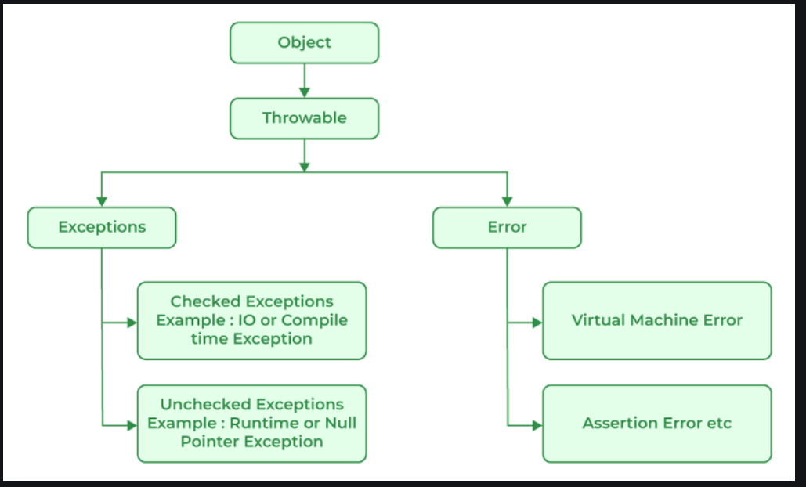

Slide 6
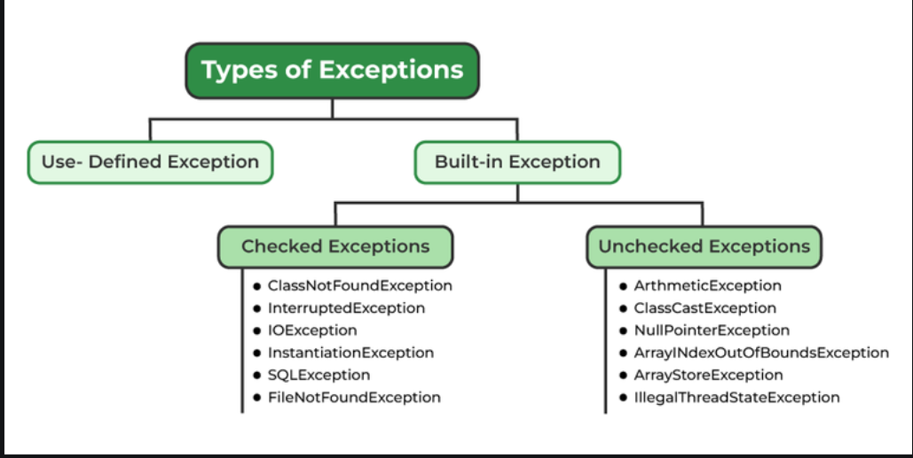
Types of Exceptions:

Slide 7
Exceptions can be categorized in two ways:
Built-in Exceptions
Checked Exception
Unchecked Exception
User-Defined Exceptions
Let us discuss the above-defined listed exception that is as follows:
1. Built-in Exceptions
Built-in exceptions are the exceptions that are available in Java libraries. These exceptions are suitable to explain certain error situations.
Checked Exceptions: Checked exceptions are called compile-time exceptions because these exceptions are checked at compile-time by the compiler.
Unchecked Exceptions: The unchecked exceptions are just opposite to the checked exceptions. The compiler will not check these exceptions at compile time. In simple words, if a program throws an unchecked exception, and even if we didn’t handle or declare it, the program would not give a compilation error.

Slide 8
2. User-Defined Exceptions:
Sometimes, the built-in exceptions in Java are not able to describe a certain situation. In such cases, users can also create exceptions, which are called ‘user-defined Exceptions’.
The advantages of Exception Handling in Java are as follows:
Provision to Complete Program Execution
Easy Identification of Program Code and Error-Handling Code
Propagation of Errors
Meaningful Error Reporting
Identifying Error Types
Methods to print the Exception information:
1. printStackTrace()
This method prints exception information in the format of the Name of the exception: description of the exception, stack trace.

Slide 9
//program to print the exception information using printStackTrace() method
import java.io.*;
class Sample {
public static void main (String[] args) {
int a=5;
int b=0;
try{
System.out.println(a/b);
}
catch(ArithmeticException e){
e.printStackTrace();
}
}
}

Slide 10
2. toString()
The toString() method prints exception information in the format of the Name of the exception: description of the exception.
//program to print the exception information using toString() method
import java.io.*;
class Sample {
public static void main (String[] args) {
int a=5;
int b=0;
try{
System.out.println(a/b);
}
catch(ArithmeticException e){
System.out.println(e.toString());
}
}
}

Slide 11
3. getMessage()
The getMessage() method prints only the description of the exception.
//program to print the exception information using getMessage() method
import java.io.*;
class GFG1 {
public static void main (String[] args) {
int a=5;
int b=0;
try{
System.out.println(a/b);
}
catch(ArithmeticException e){
System.out.println(e.getMessage());
}
}
}

Slide 12
How Programmer Handle an Exception?
Customized Exception Handling: Java exception handling is managed via five keywords: try, catch, throw, throws, and finally.
Program statements that you think can raise exceptions are contained within a try block.
If an exception occurs within the try block, it is thrown. Your code can catch this exception (using catch block) and handle it in some rational manner.
System-generated exceptions are automatically thrown by the Java run-time system.
To manually throw an exception, use the keyword throw. Any exception that is thrown out of a method must be specified as such by a throws clause.
Any code that absolutely must be executed after a try block completes is put in a finally block.
Need for try-catch clause(Customized Exception Handling) :
Consider the below program in order to get a better understanding of the try-catch clause.

Slide 13
// Java Program to Demonstrate
// Need of try-catch Clause
// Class
class Sample {
// Main driver method
public static void main(String[] args)
{
// Taking an array of size 4
int[] arr = new int[4];
// Now this statement will cause an exception
int i = arr[4];
// This statement will never execute
// as above we caught with an exception
System.out.println("Hi, I want to execute");
}
}

Slide 14
Output explanation: In the above example, an array is defined with size i.e. you can access elements only from index 0 to 3. But you trying to access the elements at index 4(by mistake) that’s why it is throwing an exception. In this case, JVM terminates the program abnormally. The statement System.out.println(“Hi, I want to execute”); will never execute. To execute it, we must handle the exception using try-catch. Hence to continue the normal flow of the program, we need a try-catch clause.
How to Use the Try-catch Clause?
try {
// block of code to monitor for errors
// the code you think can raise an exception
} catch (ExceptionType1 exOb) {
// exception handler for ExceptionType1
} catch (ExceptionType2 exOb) {
// exception handler for ExceptionType2
}
// optional
finally { // block of code to be executed after try block ends
}

Slide 15
Certain key points need to be remembered that are as follows:
In a method, there can be more than one statement that might throw an exception, So put all these statements within their own try block and provide a separate exception handler within their own catch block for each of them.
If an exception occurs within the try block, that exception is handled by the exception handler associated with it. To associate the exception handler, we must put a catch block after it. There can be more than one exception handler. Each catch block is an exception handler that handles the exception to the type indicated by its argument. The argument, ExceptionType declares the type of exception that it can handle and must be the name of the class that inherits from the Throwable class.
For each try block, there can be zero or more catch blocks, but only one final block.
The finally block is optional. It always gets executed whether an exception occurred in try block or not. If an exception occurs, then it will be executed after try and catch blocks. And if an exception does not occur, then it will be executed after the try block. The finally block in Java is used to put important codes such as clean-up code e.g., closing the file or closing the connection.
If we write System.exit in the try block, then finally block will not be executed.

Slide 16
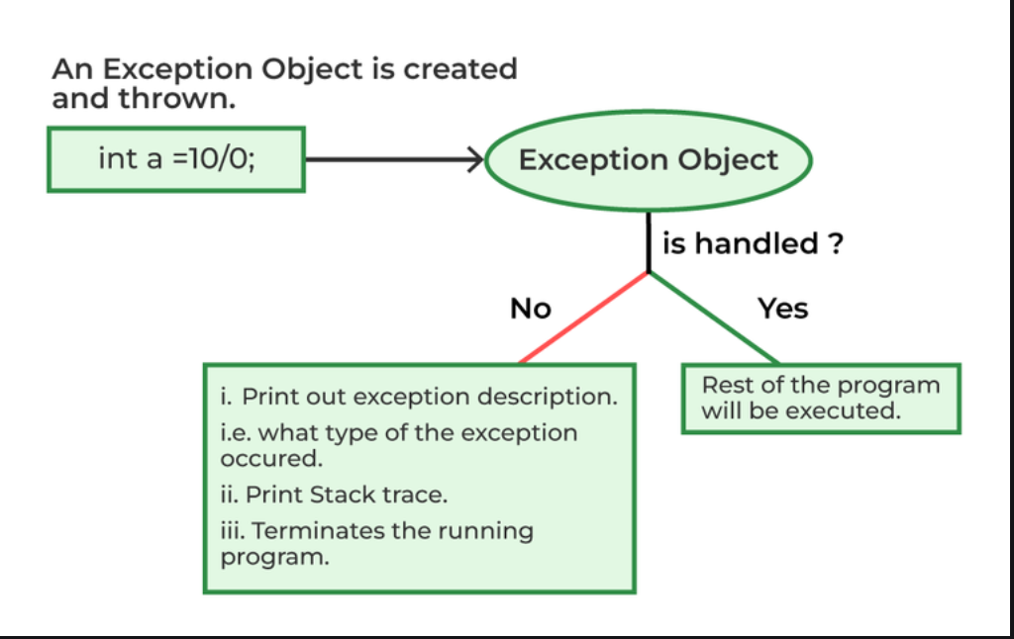

Slide 17
throw and throws in Java
throw Instance Example: throw new ArithmeticException("/ by zero");
In Java, Exception Handling is one of the effective means to handle runtime errors so that the regular flow of the application can be preserved. Java Exception Handling is a mechanism to handle runtime errors such as ClassNotFoundException, IOException, SQLException, RemoteException, etc.
Java throw :
The throw keyword in Java is used to explicitly throw an exception from a method or any block of code. We can throw either checked or unchecked exception. The throw keyword is mainly used to throw custom exceptions.
throw Instance
Example:
throw new ArithmeticException("/ by zero");

Slide 18
// Java program that demonstrates the use of throw
class ThrowExcep {
static void fun()
{
try {
throw new NullPointerException("demo");
}
catch (NullPointerException e) {
System.out.println("Caught inside fun().");
throw e; // rethrowing the exception
}
}
public static void main(String args[])
{
try {
fun();
}
catch (NullPointerException e) {
System.out.println("Caught in main.");
}
}
}

Slide 19
Java throws :
throws is a keyword in Java that is used in the signature of a method to indicate that this method might throw one of the listed type exceptions. The caller to these methods has to handle the exception using a try-catch block.
Syntax of Java throws
type method_name(parameters) throws exception_list
exception_list is a comma separated list of all the
exceptions which a method might throw.

Slide 20
// Java program to demonstrate working of throws
class ThrowsExecp {
static void fun() throws IllegalAccessException
{
System.out.println("Inside fun(). ");
throw new IllegalAccessException("demo");
}
public static void main(String args[])
{
try {
fun();
}
catch (IllegalAccessException e) {
System.out.println("caught in main.");
}
}
}

Slide 21
Try Catch Finally
class Main {
public static void main(String args[]) {
try {
int a = 15;
int b = 0;
System.out.println("Value of a = " + a);
System.out.println("Value of b = " + b);
int c = a / b;
System.out.println("a / b = " + c);
}
catch (Exception e) {
System.out.println("Exception Thrown: " + e);
}
finally {
System.out.println("Finally block executed!");
}
}
}

Slide 22
Interfaces in Java :
An Interface in Java programming language is defined as an abstract type used to specify the behavior of a class.
An interface in Java is a blueprint of a behavior. A Java interface contains static constants and abstract methods.
What are Interfaces in Java?
The interface in Java is a mechanism to achieve abstraction. There can be only abstract methods in the Java interface, not the method body.
It is used to achieve abstraction and multiple inheritances in Java using Interface.
In other words, you can say that interfaces can have abstract methods and variables.
It cannot have a method body. Java Interface also represents the IS-A relationship.
When we decide on a type of entity by its behavior and not via attribute we should define it as an interface.

Slide 23
Syntax for Java Interfaces :
interface {
// declare constant fields
// declare methods that abstract
// by default.
}
To declare an interface, use the interface keyword. It is used to provide total abstraction.
An interface are declared with an empty body and are public and all fields are public, static, and final by default.
A class that implements an interface must implement all the methods declared in the interface. To implement the interface, use the implements keyword.

Slide 24
Uses of Interfaces in Java are mentioned below:
It is used to achieve total abstraction.
Since java does not support multiple inheritances in the case of class, by using an interface it can achieve multiple inheritances.
Any class can extend only 1 class, but can any class implement an infinite number of interfaces.
It is also used to achieve loose coupling.
Interfaces are used to implement abstraction.
Syntax :
// A simple interface
interface Player
{
final int id = 10;
int move();
}

Slide 25
// interface
@FunctionalInterface // annotation
interface interfaceName{
// abstract method
abstract returnType methodName( /* parameters */);
// default or static methods
int method1(){
// ....
}
String method2(int x, float y){
// ....
}
}
// public class
public class className{
// main method
public static void main(String[] args){
interfaceName temp = (/*parameters*/) -> {
// perform operations
};
temp.methodName(); // call abstract method of the interface
}
}

Slide 26
The functional interface in Java is defined just like normal interfaces. It should only have one abstract method. Though it can contain multiple default or static methods.
Abstract keyword: Though from Java 8, interfaces can have static and default methods. By default, methods in interfaces are abstract only. So it is not mandatory to mention the abstract keyword before the method.
To implement the abstract method of a functional interface in Java, we can either use lambda expression or we can implement the interface to our class and override the method. In the syntax above we are using a lambda expression.

Slide 27
Java Interfaces Examples
// Java program to demonstrate the
// real-world example of Interfaces
import java.io.*;
interface Vehicle {
// all are the abstract methods.
void changeGear(int a);
void speedUp(int a);
void applyBrakes(int a);
}
class Bicycle implements Vehicle{
int speed;
int gear;
// to change gear
@Override
public void changeGear(int newGear){
gear = newGear;
}
// to increase speed
@Override
public void speedUp(int increment){
speed = speed + increment;
}

Slide 28
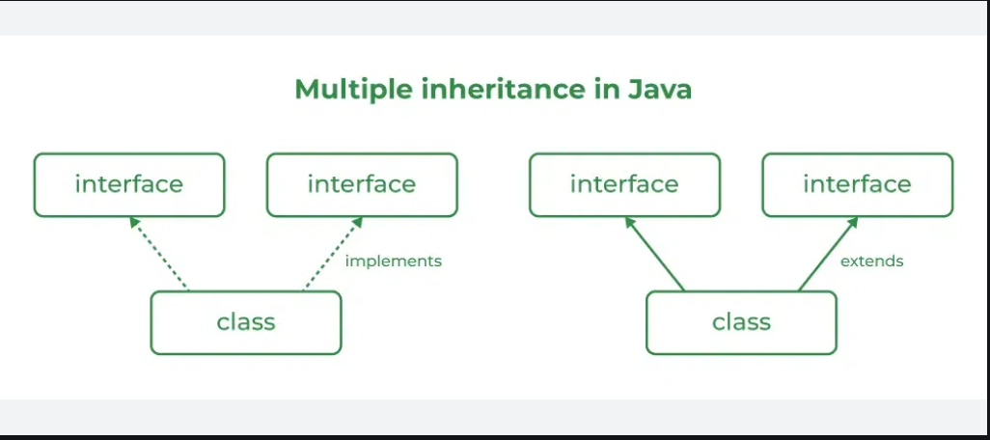
Multiple Inheritance in Java Using Interface :
Multiple Inheritance is an OOPs concept that can’t be implemented in Java using classes. But we can use multiple inheritances in Java using Interface. let us check this with an example.

Slide 29
// Java program to demonstrate How Diamond Problem
// Is Handled in case of Default Methods
// Interface 1
interface API {
// Default method
default void show()
{
// Print statement
System.out.println("Default API");
}
}

Slide 30
// Interface 2
// Extending the above interface
interface Interface1 extends API {
// Abstract method
void display();
}
// Interface 3
// Extending the above interface
interface Interface2 extends API {
// Abstract method
void print();
}

Slide 31
// Main class
// Implementation class code
class TestClass implements Interface1, Interface2 {
// Overriding the abstract method from Interface1
public void display()
{
System.out.println("Display from Interface1");
}
// Overriding the abstract method from Interface2
public void print()
{
System.out.println("Print from Interface2");
}
// Main driver method
public static void main(String args[])
{
// Creating object of this class
// in main() method
TestClass d = new TestClass();
// Now calling the methods from both the interfaces
d.show(); // Default method from API
d.display(); // Overridden method from Interface1
d.print(); // Overridden method from Interface2
}
}

Slide 32
Extending Interfaces :
One interface can inherit another by the use of keyword extends. When a class implements an interface that inherits another interface, it must provide an implementation for all methods required by the interface inheritance chain.
interface A {
void method1();
void method2();
}
// B now includes method1 and method2
interface B extends A {
void method3();
}
// the class must implement all method of A and B.
class gfg implements B {
public void method1()
{
System.out.println("Method 1");
}
public void method2()
{
System.out.println("Method 2");
}
public void method3()
{
System.out.println("Method 3");
}
}

Slide 33
The Java I/O Filter :
The Java I/O Filter is inside java.io package. It provides sets of input and output streams used for reading and writing data to input and output sources.
There are different types of classes in java.io, naming Input Stream, Output Stream, etc.
Input Stream:
The InputStream class of java.io is an abstract superclass which reads data from an input source.
The source can be a file, a string, or anything that can contain data.
This class is a programming interface for reading array of bytes, marking locations in the stream, skipping input bytes, determining number of readable bytes and resetting current position within the stream.
While creation, an input stream is automatically opened. One can close a stream manually using the clone() method, or can close it by default when the object is garbage collected.

Slide 34
Some methods included in the InputStream class are :
read()
read(byte[] array)
available()
mark()
reset()
markSupported()
skips()
close()
Syntax :
InputStream object = new FileInputStream();

Slide 35
import java.io.FileInputStream; // importing Input Stream class in java.io package
import java.io.InputStream;
class InputStreamExample { // class declaration
public static void main(String args[]){ // main function declaration
byte[] array = new byte[100]; // byte array initialization
try {// try block
InputStream input = new FileInputStream("File.txt"); // Input Stream class object created
System.out.println("Available bytes in the file: " + input.available());
input.read(array); // reading byte from input stream
System.out.println("Data read from the file: ");
String data = new String(array); // converting byte array into string
System.out.println(data);
input.close(); // closing the input stream
}
catch (Exception e) { // catch block
e.getStackTrace();
}
}
}

Slide 36
Output Stream :
The OutputStream class of java.io is an abstract superclass which writes data to an output source.
The source can be a file, a string, memory or anything that can contain data.
It is a sibling to InputStream and can write data that is readable by InputStream.
This class is a programming interface for writing array of bytes to the stram and flushing the stream.
While creation, an output stream is automatically opened. One can close a stream manually using the clone() method, or can close it by default when the object is garbage collected.

Slide 37
Some methods included in the OutputStream class are :
write()
write(byte[] array)
flush()
close()
Syntax :
OutputStream object = new FileOutputStream();

Slide 38
import java.io.OutputStream;
public class OutputStreamExample { // class declaration
public static void main(String args[]) { // main function declaration
String data = "Hello Readers!! Welcome to TutorialsPoint"; // string variable storing line to be written in File.txt
try { // try block
OutputStream out = new FileOutputStream("File.txt"); // Output Stream class object created
byte[] dataBytes = data.getBytes(); // Converts the string into bytes
out.write(dataBytes); // Writes data to the output stream
System.out.println("Data is written to the file.");
out.close(); // Closes the output stream
}
catch (Exception e) { // catch block
e.getStackTrace();
}
}
}

Slide 39
Stream filter() in Java :
Stream<T> filter(Predicate<? super T> predicate)
Stream<T> filter(Predicate<? super T> predicate)
Stream filter(Predicate predicate) returns a stream consisting of the elements of this stream that match the given predicate.
This is an intermediate operation.
These operations are always lazy i.e, executing an intermediate operation such as filter() does not actually perform any filtering, but instead creates a new stream that, when traversed, contains the elements of the initial stream that match the given predicate.
Syntax:
Stream<T> filter(Predicate<? super T> predicate)

Slide 40
// Java Program to get a Stream Consisting of the Elements
// of Stream that Matches Given Predicate for Stream filter
// (Predicate predicate)
// Importing required classes
import java.util.*;
// Class
class GFG {
// Main driver method
public static void main(String[] args)
{
// Creating a list of Integers
List<Integer> list = Arrays.asList(3, 4, 6, 12, 20);
// Getting a stream consisting of the
// elements that are divisible by 5
// Using Stream filter(Predicate predicate)
list.stream()
.filter(num -> num % 5 == 0)
.forEach(System.out::println);
}
}

Slide 41
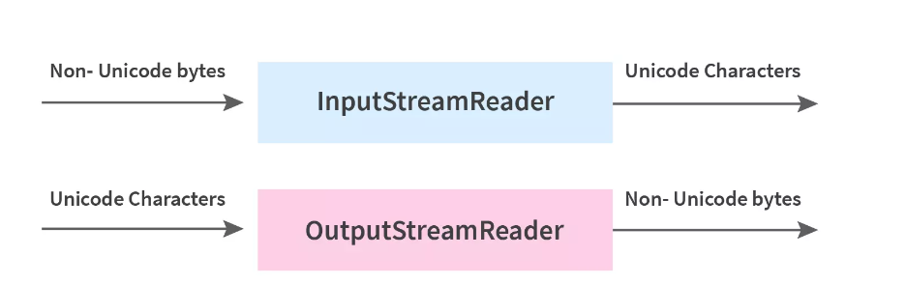
Byte Stream :
The stream method helps to sequentially access a file. There are two types of streams in Java- Byte Stream and Character Stream.
Byte streams in Java are used to perform input and output operations of 8-bit bytes while the Character stream is used to perform input and output operations for 16-bits Unicode.
Character streams are useful in reading or writing text files which are processed character by character. Byte Streams are useful to read/write data from raw binary files.
The stream method helps to sequentially access a file. Some streams simply pass on the data while some manipulate and transform the data in a useful way.
The java.io package contains classes that allow the user to convert between Unicode character streams and byte streams of non-Unicode text.

Slide 42
Syntax :
FileInputStream :
FileInputStream sourceStream = new FileInputStream("path_to_file");
FileOutput Stream :
FileOutputStream targetStream = new FileOutputStream("path_to_file");

Slide 43
import java.io.*;
public class ByteStreamExample
{
public static void main(String[] args) throws IOException
{
FileInputStream sourceStream = null;
FileOutputStream targetStream = null;
try
{
sourceStream = new FileInputStream("source.txt");
targetStream = new FileOutputStream ("destination.txt");
// Reading source file using read method
// and write to file byte by byte using write method
int temp;
while ((temp = sourceStream.read()) != -1)
targetStream.write((byte)temp);
}
finally
{
if (sourceStream != null){
sourceStream.close();
}
if (targetStream != null){
targetStream.close();
}
}
}
}

Slide 44
Thank you

